Slide 1
Pre-training for Open-domain Dialogue
赵学亮
2021.11.2

Slide 2
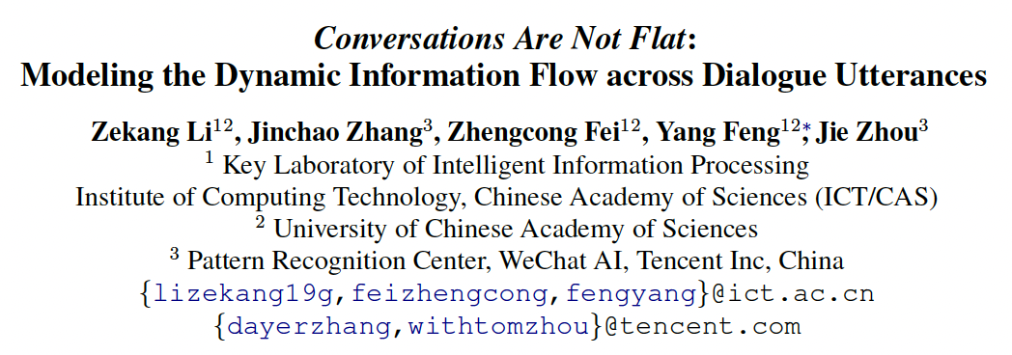

Slide 3
Previous work and Challenges
Most of the previous work on dialogue history modeling mainly fall into two groups
Flat pattern:
concatenate the dialogue history as the model input and predict the response
ignore the conversational dynamics across utterances in the dialogue history
Hierarchical modeling:
utterances are separately encoded and then fed into an utterance-level encoder
lack the history information when encoding each individual utterance.

Slide 4
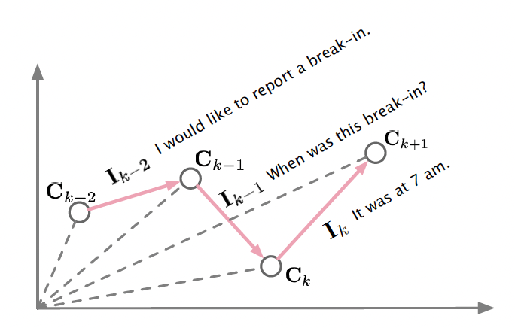
Proposed Method
Propose the DialoFlow to model the dynamic information flow in the dialogue history.
Contexts: dense representation of the dialogue history.
Semantic influence: measured by the difference between two adjacent contexts.

Slide 5
Contributions
propose the DialoFlow, a new paradigm to construct the dynamic information flow in the dialogue history.
Design an automatic reference-free evaluation metric Flow score based on the pre-trained DialoFlow for interactive dialogue quality evaluation.

Slide 6
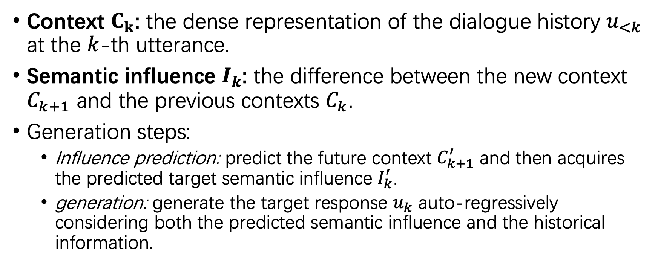
Method
Context $C_{k}$: the dense representation of the dialogue history $u_{<k}$ at the $k$-th utterance.
Semantic influence $I_{k}$: the difference between the new context $C_{k+1}$ and the previous contexts $C_{k}$.
Generation steps:
Influence prediction: predict the future context $C_{k+1}^{′}$ and then acquires the predicted target semantic influence $I_{k}^{′}$.
generation: generate the target response $u_{k}$ auto-regressively considering both the predicted semantic influence and the historical information.

Slide 7
Model Architecture
Input Embedding
takes the sum of token embeddings, segment embedding, and position embedding as the model input
insert a special token “[C]”at the end of each utterance to capture the overall dense representation of the dialogue history (causal mask)

Slide 8


Model Architecture
Transformer Block
employ the pre-normalization used in GPT-2 instead of post-normalization used in BERT to enable stable large-scale training.
obtain the history context at the $k$-th utterance:

Slide 9


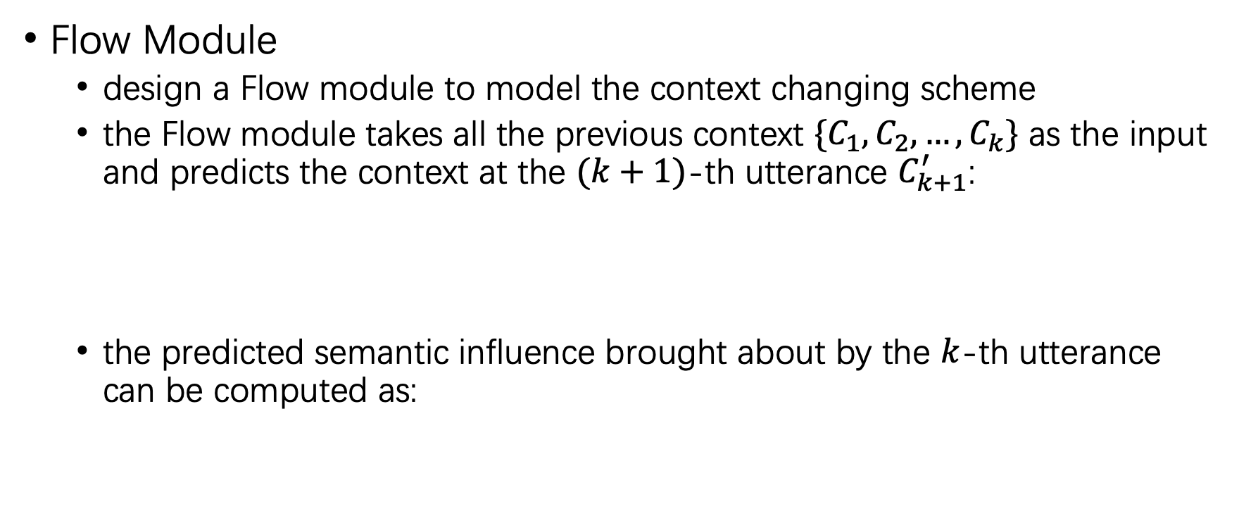
Model Architecture
Flow Module
design a Flow module to model the context changing scheme
the Flow module takes all the previous context $\{C_{1}, C_{2},…,C_{k}\}$ as the input and predicts the context at the $(k+1)$-th utterance $C_{k+1}^{′}$:
the predicted semantic influence brought about by the $k$-th utterance can be computed as:

Slide 10
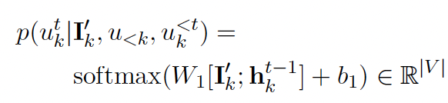

Model Architecture
Response Generator
generate the utterance $u_{k}$ with the guidance of the predicted semantic influence $I_{k}^{′}$
takes the predicted semantic influence $I_{k}^{′}$ and the hidden states $h_{k}^{t−1}$ as input, and outputs the probability distribution of the $t$-th word:

Slide 11
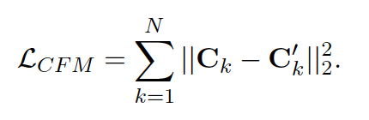

Training Objectives
Context Flow Modeling:
predicts the context at the k-th utterance $C_{k}^{′}$ based on the previous context sequence $\{C_{1}, …,C_{k−1}\}$.
minimize the L2 distance between the predicted context $C_{k}^{′}$ and the real context $C_{k}$:

Slide 12

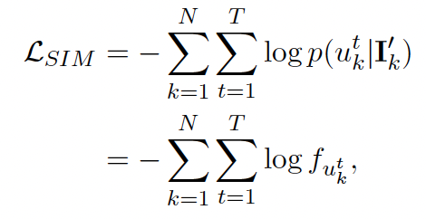

Training Objectives
Semantic Influence Modeling:
function $f:$
design a bag-of-words loss using the predicted semantic influence $I_{n}^{′}$:

Slide 13
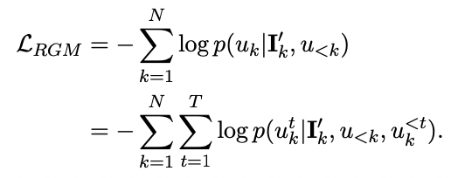


Training Objectives
Response Generation Modeling:
incorporate the predicted semantic influence $I_{k}^{′}$ into the response generation stage:
The overall training objective:

Slide 14
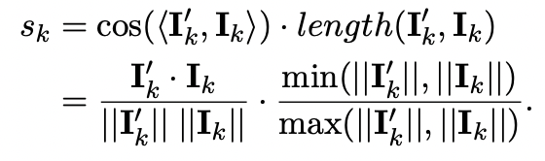
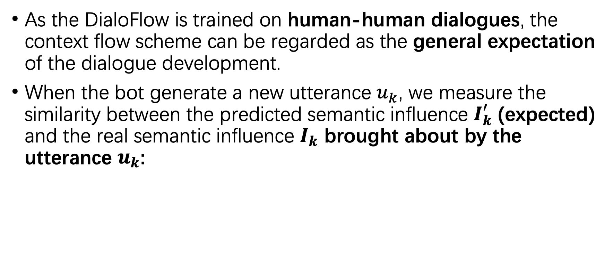
Flow Score
As the DialoFlow is trained on human-human dialogues, the context flow scheme can be regarded as the general expectation of the dialogue development.
When the bot generate a new utterance $u_{k}$, we measure the similarity between the predicted semantic influence $I_{k}^{′}$ (expected) and the real semantic influence $I_{k}$ brought about by the utterance $u_{k}$:
length similarity

Slide 15


Flow Score
The turn numbers of the chatbot utterances $M$
The overall quality of the dialogue is measured by:

Slide 16
Experiments
Dataset: (1) Reddit; (2) DailyDialog.
Baseline: DialoGPT.
Evaluation Metrics:
reference-based: BLEU, NIST, METEOR
other: Entropy

Slide 17
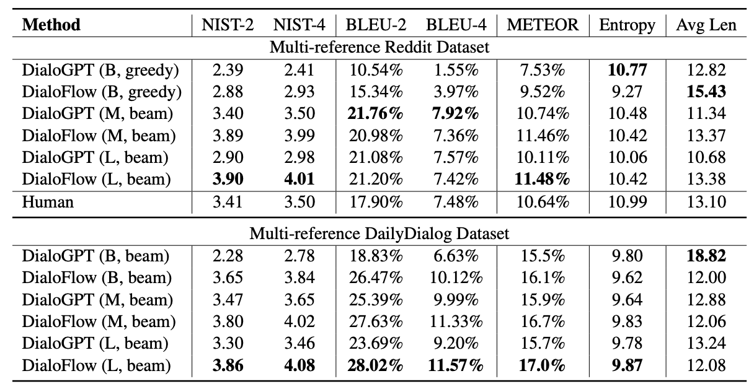
Main Results
DialoFlow-large achieves the highest score on the NIST and METEOR on Reddit.
DialogFlow show significant improvements on all model sizes and on all metrics on DailyDialog.
The performance of DialoFlow increases with the model size.

Slide 18
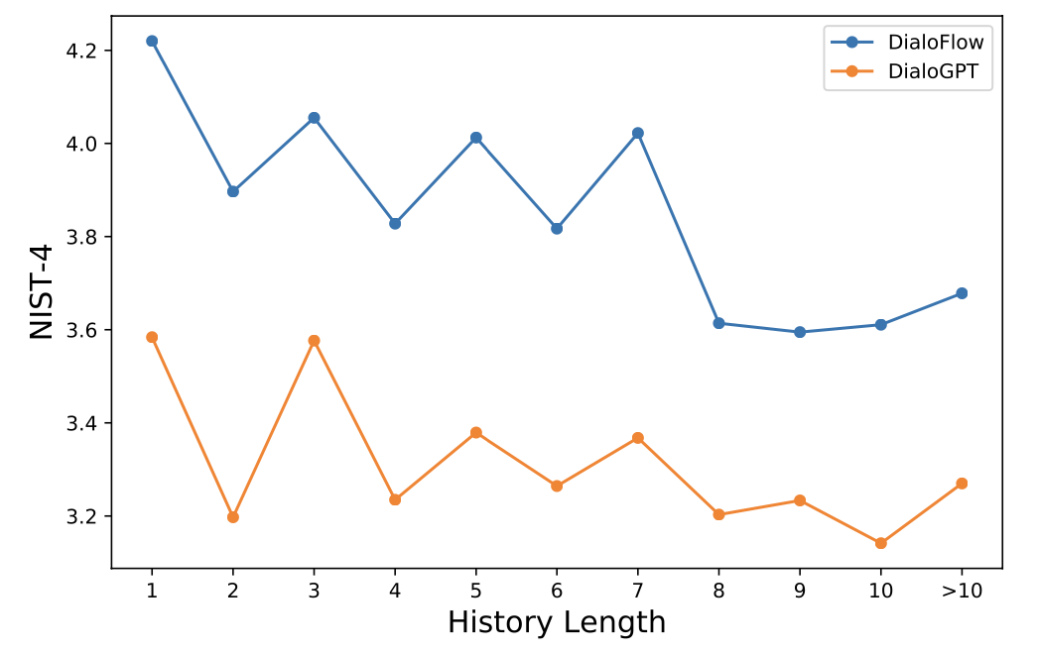
Analysis of dialogue history length
DialoFlow achieves better performance on all history lengths.

Slide 19
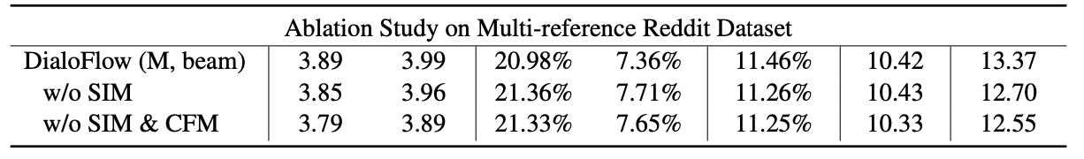
Ablation Study
When drop the SIM task, the performance slightly decreases.
When further drop the CFM task, the performance decreases again.
The CFM task is effective and the SIM task can prompt the CFM task.

Slide 20
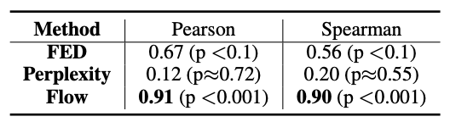
Dialogue Evaluation
The Table shows the chatbot-level correlations of different automatic metrics with human ratings on the DSTC9 Interactive Conversation dataset.
The proposed Flow score can effectively estimate the overall chatbot quality.

Slide 21
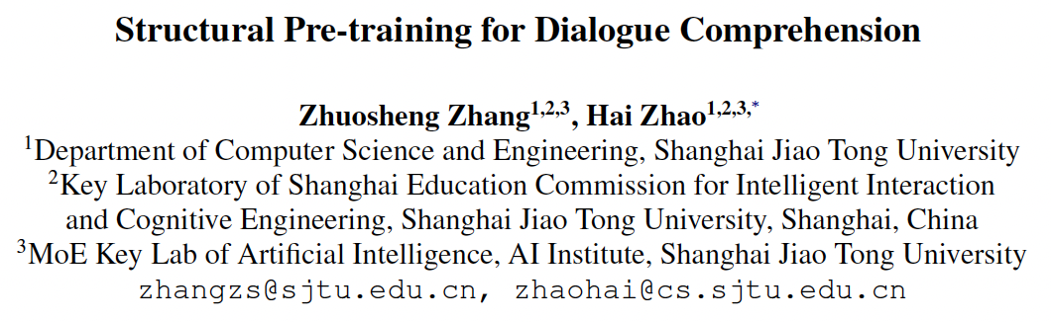

Slide 22
Challenges
There are increasing studies that employ PrLMs for conversation modeling …
These studies model the response selection with only the context-response matching task(i.e., MLM, NSP) and overlook many potential training signals(e.g., speaker role, continuity and consistency) in dialogue data.
Some latent features(e.g., intent and topic) are under-discovered in existing works.

Slide 23
Proposed Method
Utterance order restoration (UOR): predict the order of the permuted utterances in dialogue context;
Sentence backbone regularization (SBR): regularize the model to improve the factual correctness of summarized subject-vert-object triplets.

Slide 24
Approach
The proposed method: SPIDER (Structural Pre-traIned DialoguE Reader)
The standard dialogue comprehension model as the backbone
The designed language modeling objectives
Model Training
domain adaptive post-training
multi-task fine-tuning that trains the model for downstream task along with LM objectives.

Slide 25
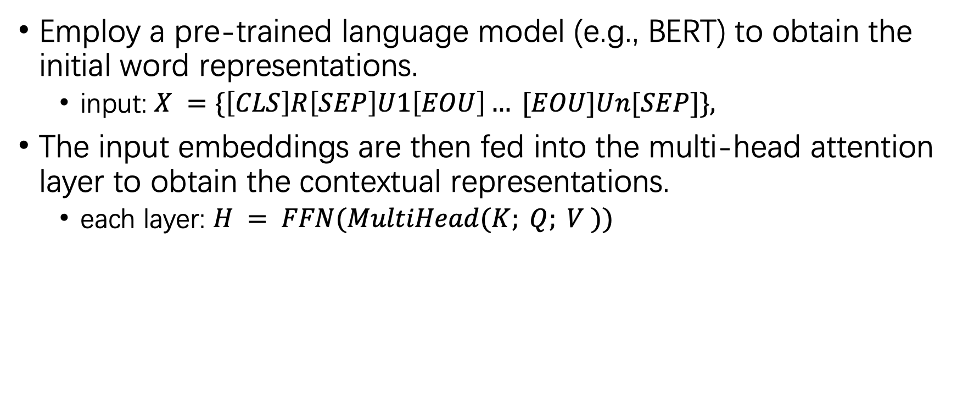
Transformer Encoder
Employ a pre-trained language model (e.g., BERT) to obtain the initial word representations.
input: $X =\{\left[CLS\right]R\left[SEP\right]U1\left[EOU\right]… [EOU]Un[SEP]\},$
The input embeddings are then fed into the multi-head attention layer to obtain the contextual representations.
each layer: $H = FFN(MultiHead(K; Q; V ))$

Slide 26
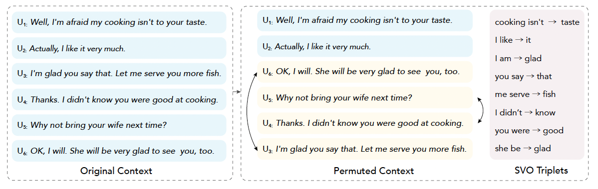
SPIDER Training Objectives
Structural language modeling manipulations:

Slide 27
Utterance Order Restoration
Assumption: In a coherent discourse, utterances should respect specific orders of relations and logic.
The goal of utterance order restoration is to organize randomly shuffled utterances of a conversation into a coherent dialogue context.
Notes:
有的文本句子间是并列关系
一个好的对话模型应该能捕捉到句子间的逻辑关系

Slide 28
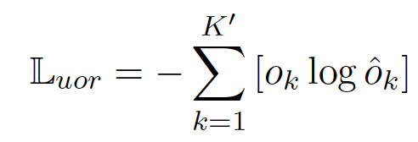
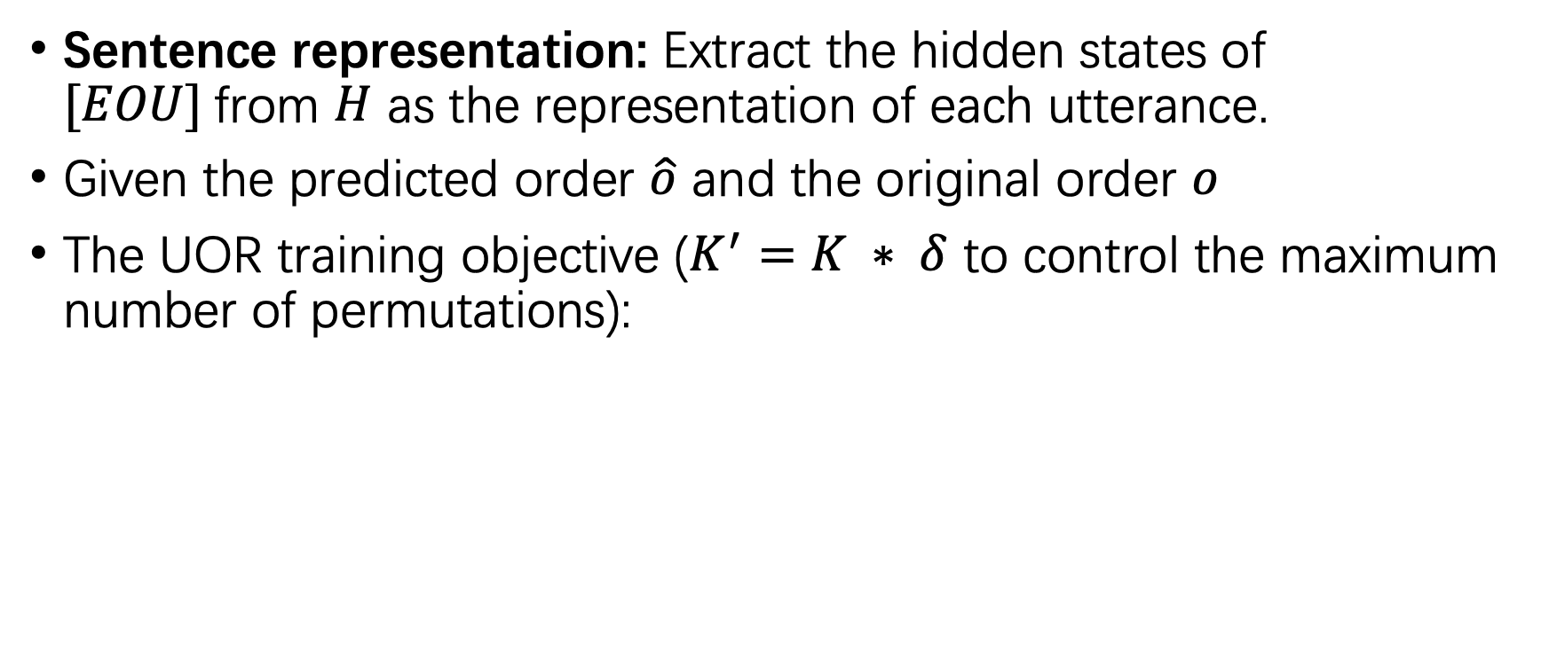
Utterance Order Restoration
Sentence representation: Extract the hidden states of $[EOU]$from $H$ as the representation of each utterance.
Given the predicted order $\hat{o}$ and the original order $o$
The UOR training objective ($K^{′}=K ∗ δ$ to control the maximum number of permutations):
Notes:
Ok是一个one-hot vector，O-hat-k是一个distribution。模型需要预测第k个位置的句子在原始上下文中的位置。

Slide 29

Sentence Backbone Regularization
Guide the model to distinguish the internal relation of the fact triplets that are extracted from each utterance.
Subject-Verb-Object Triplet：
apply a fact extractor to conduct the dependency parsing of each sentence
extract the subject, the root verb, and the object tokens as an SVO triple
Assume that in the hidden representation space, the summation of the subject and the verb should be close to the object:

Slide 30
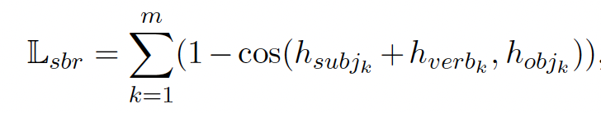

Sentence Backbone Regularization
The regularization for the extracted facts:
the total number of fact tuples $m$
the indexes of the $k$-th fact tuple: ${subj}_{k}$, ${verb}_{k}$, ${obj}_{k}$

Slide 31


Domain Adaptive Post-training
The overall post-training loss is the sum of the MLM, NSP, UOR and SBR loss:
$λ_{1}$, $λ_{2}$, $λ_{3}$ are hyper-parameters

Slide 32


Multi-task Fine-tuning
Feed the permuted context to the dialogue comprehension model and combine the three losses for training:
$β_{1}$, $β_{2}$, $β_{3}$ are hyper-parameters.

Slide 33
Experiment
Dataset: (1) Ubuntu; (2) MuTual; (3) Douban; (4) E-commerce.
Baseline Models:
Multi-turn matching models: (1) SMN; (2) DAM; (3) DUA; (4) IOI; (5) MRFN; (6) MSN;
PrLM—based models: (1) BERT; (2) SA-BERT; (3) ELECTRA.

Slide 34
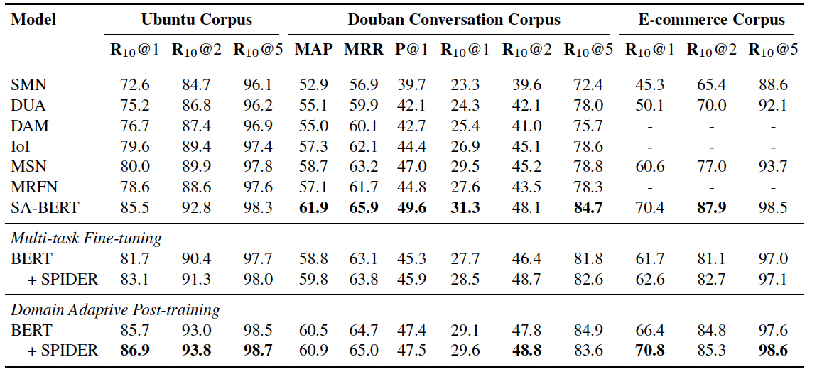
Main Results
PrLM can perform even better when equipped with our SPIDER objectives.
DAP generally works better than MTF.

Slide 35
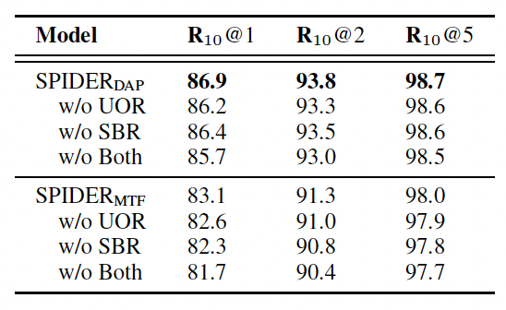
Ablation Study
UOR shows better performance than SBR in DAP.
In MFT, the permutation of the context would possibly bring some negative effects to the downstream task training.

Slide 36
Pre-training for Open-domain Dialogues
Contextualized Representations:
Improving Matching Models with Hierarchical Contextualized Representations for Multi-turn Response Selection (SIGIR-20)
Pretraining Methods for Dialog Context Representation Learning (ACL-19)
PLMs-based
TransferTransfo (NeurIPS-2018-workshop); DialoGPT (ACL-20-demo); PLATO (ACL-2020)
Self-supervision
DialogBERT (AAAI-2021)
Information Flow
DialoFlow (ACL-2021)
Industry
Meena (Google-2020); BlenderBot (Facebook-2020); BlenderBot 2.0 (Facebook-2021); PLATO-2(Baidu-2020); PLATO-XL (Baidu-2021)

